Slide 1
FHIM + S&I Framework: Advancing Interoperability for Enhanced Health Information Exchange
Steven Wagner
Evelyn Gallego-Haag

Slide 2
Introductory Statement
The following presentation has educational value and is not for the purpose of marketing any products or services.
2

Slide 3

Agenda
Overview of FHA
Federal Partner Priorities
Overview of FHIM & S&I Framework
Standards and their Importance to Health Information Exchange
Involvement of FHIM in S&I Framework Initiatives to Advance Interoperability within HIE
Getting Involved with FHIM and S&I Framework Initiatives
3
Notes:
During our presentation today, Evelyn and I will introduce you to the Federal Health Architecture, Federal Health Information Model and Standards & Interoperability Framework respectively. We will also highlight some of the major activities we are working on with the FHIM and S&I Framework, and how we hope to engage both areas to enhance the interoperability of health information across the public and private enterprise.

Slide 4

FHA Overview
Established by the Office of Management and Budget as an E-Government Line of Business (LoB) Initiative
Supports federal activities related to the development and adoption of health IT standards and policies
Ensures that federal agencies seamlessly and securely exchange health data with other agencies, government entities, and with other public and private organizations
4
Notes:
The Office of Management and Budget established the FHA as an E-Government Line of Business in 2007. The Office of the National Coordinator for Health IT became our Managing Partner in 2008. Since then, we have been working with more than 20 federal agencies involved in healthcare to encourage the adoption of national health IT standards and policies. We also work with our partners to convene meetings to identify and work on priority health IT topics in order to ensure the seamless exchange of health data between the partners and other agencies and private organizations.

Slide 5



























What is FHA
Currently partnering with more than 20 federal agencies including the Department of Health and Human Services, Department of Defense, Centers for Medicare & Medicaid Services, Department of Veterans Affairs, Social Security Administration and Indian Health Services
5
Notes:
These are some of the partners that we are working with or have worked with since our inception. Our funding partners include the Department of Health and Human Services, Centers for Medicare & Medicaid Services, Department of Defense, Department of Veterans Affairs, Social Security Administration and Indian Health Services.

Slide 6





FHA Strategic Plan - Vision
Communicate (Facilitate information sharing to convene best approaches)
FOCUS ON SPECIFICATIONS
Capture
(Architect Federal HIT)
COMMITMENT TO ACTION
Better Care
Increased Efficiency
Improved Population Health
STAKEHOLDER ENGAGEMENT
Design (Promote, oversee, coach, pilot potential Shared Services)
Analyze (Gap / Overlap Analyses To Derive Shared Service Opportunities)
OPEN COMMUNICATION & TRANSPARENCY
DEMONSTRATE THROUGH PILOTS
6
Notes:
FHA believes that a federal health information technology environment that is fully interoperable and supports the President’s health IT plan enables better care, increased efficiency and improved population health.

Slide 7
FHA Precepts
Capture (Architect federal HIT)
Provide a structured description of the federal health landscape
Version architecture elements for authoritative references (federated architecture)
Analyze (Gap / Overlap Analyses to derive Shared Service opportunities)
Identify gaps in Health Information Exchanges (HIE) approaches
Guide decision makers on programmatic and strategic initiatives and processes
Design (Promote, oversee, coach, pilot potential Shared Services)
Support federal HIE standards implementation and interoperability
Purposefully arrange architecture elements for optimal discovery and use by federal partners
Communicate (Facilitate information sharing to convene best approaches )
Convey federal position & understanding of complex health interdependencies
Support agencies’ budget requests in health space as coordinated
Coordinate federal participation in identified work groups
7
Notes:
These FHA precepts are key to our vision. These precepts outline the general responsibilities of FHA.

Slide 8



Goals for Health Information Exchange
Enable health information to flow securely across organizational, jurisdictional and vendor boundaries to
inform clinical decisions at the point of care
improve the quality, safety and efficiency of care coordination
engage patients and families in care
8
Notes:
FHA’s goals for health information exchange nationwide are in alignment with ONC’s goals. These three goals support the notion that informing providers with access to the right information will improve health care and encourage the engagement of patients and families in their own health care.

Slide 9

FHA Initiatives and Federal Partner Priorities
CONNECT
Directed Exchange
Healthcare Directory
Patient Consent & Authorization
Federal Health Information Model (FHIM)
9
Notes:
Currently, these are the priority areas for our federal partners. There are more and FHA will work with the partners on those additional priorities as these current areas are successfully completed. If you have questions about the other priority areas, please contact feel free to email me and I will get your request over to FHA Director Gail Kalbfleisch for response.

Slide 10

Federal Health Information Model
A Logical Information Model of Health Data developed in collaboration with the federal agencies
Harmonizes content (information, terminologies and value sets) across federal partners and standards organizations
Working on integrating with open source Model Driven Health Tools (MDHT)
Can generate HIE Implementation standards for multiple Platform Specific Models (PSMs)
10

Slide 11
Engagement Opportunities with the Standards & Interoperability Framework
FHIM
S&I
Support for federal partner priorities such as Meaningful Use
Direct support of federal partner use cases
Provide semantic and syntactic modeling constructs to support the definition of information
Combined with MDHT*, can be used to generate implementation standards using an MDA* approach
Scope
Pre-Discovery
Requirements
Use Case
Harmonization
Modeling
Reference Implementation, Test & Pilot
*MDHT= Model Driven Health Tools
MDA= Model Driven Architecture
Publish
Evaluation
11

Slide 12
Deliverables
Completed
Model 17 of 37 FHIM information domains
Terminology modeling of 9 of 17 FHIM domains
Integration of FHIM and associated terminology models with Model Driven Health Tools (MDHT)
Process guides
Prototyping of each individual process, model and tool
Prototyping of HIE Framework
Generation of a draft implementation standard in CDA & NIEM
Map at least five S&I Framework initiatives
Notes:
Information modeling of 17 of 37 FHIM information domains (e.g., Person, Lab, Medications, Health Concerns/Problems, Orders, etc.)
Terminology modeling of 9 of 17 FHIM domains
Integration of FHIM and associated terminology models with Model Driven Health Tools (MDHT)
A complete set of process guides for information, terminology and implementation modeling. Process guides are both a deliverable and a benefit
Prototyping of each individual process, model and tool
Prototyping of HIE Framework (fully integrated processes, models and tools that support the Model Driven Architecture approach to generating HIE standards)
Generation of a draft implementation standard for the exchange of immunization information in both a CDA and NIEM format
Mappings between FHIM and at least five S&I Framework initiatives
Definition of a UML profile to support enhanced report generation
Definition and generation of a draft comparative report between two versions of the FHIM

Slide 13
Deliverables…Continued
In Process
Model 20 of 37 FHIM information domains
Terminology modeling of 26 of 37 FHIM domains
Definition of a UML profile to support enhanced report generation
Draft comparative report between two versions of the FHIM
Notes:
Information modeling of remaining 20 of 37 FHIM information
Terminology modeling of remaining 26 of 37 FHIM domains
Definition of a UML profile to support enhanced report generation
Definition and generation of a draft comparative report between two versions of the FHIM

Slide 14
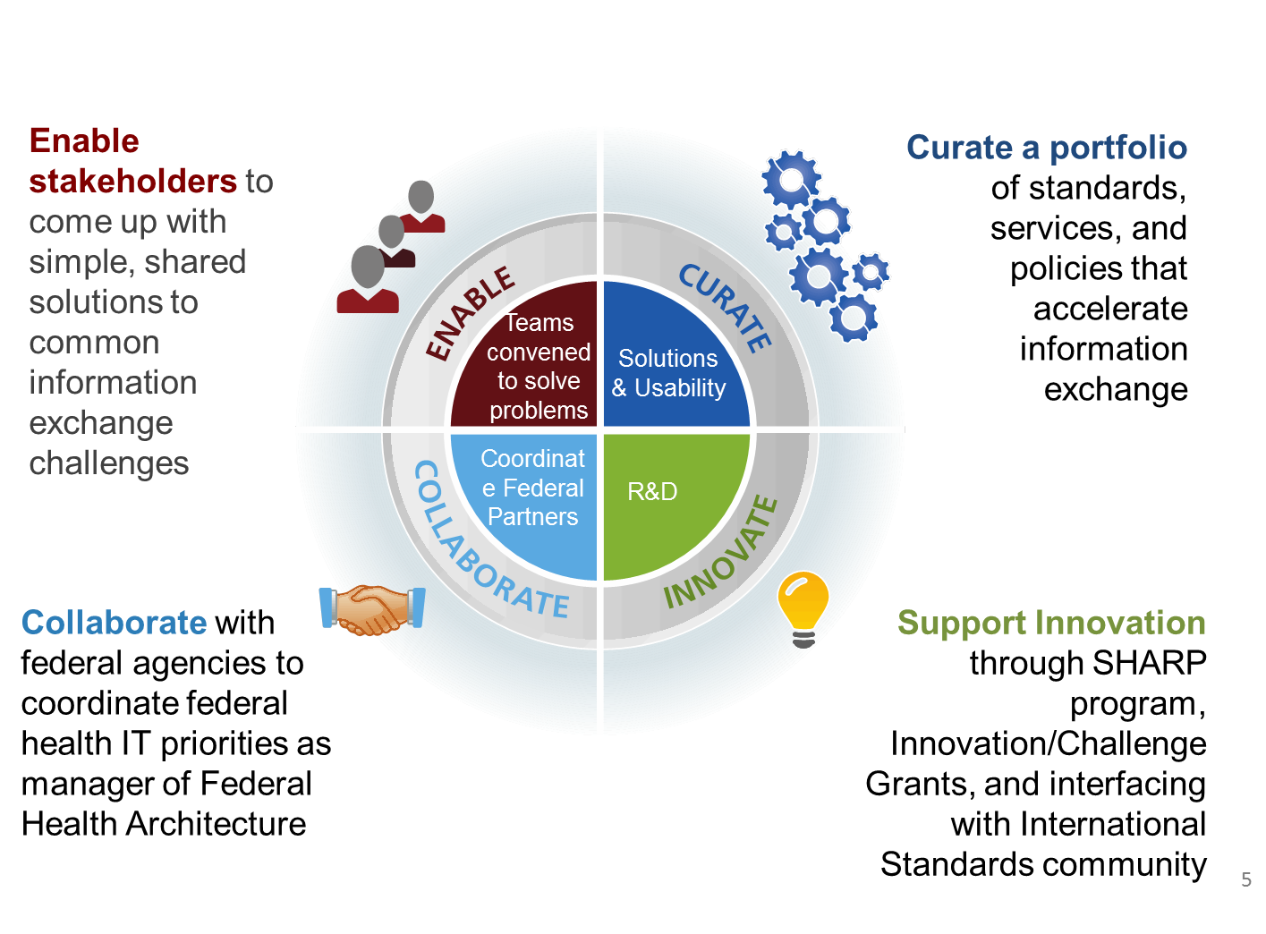
Office of Standards & Technology

Slide 15

What is the S&I Framework?
The Standards and Interoperability (S&I) Framework represents one investment and approach adopted by ONC to fulfill its charge of prescribing health IT standards and specifications to support national health outcomes and healthcare priorities
Consists of a collaborative community of participants from the public and private sectors who are focused on providing the tools, services and guidance to facilitate the functional exchange of health information
Uses a set of integrated functions, processes, and tools that enable execution of specific value-creating initiatives
15

Slide 16
S&I Framework: The Value of Community Participation
ENABLING
FACAs
HIT Standards Committee
HIT Policy Committee
Tiger Team
Community
S&I Framework
SDOs
Technology Vendors
System Integrators
Government Agencies (National & International)
Industry Associations
Other Experts
HL7
IHE
CDISC
Other SDOs
ONC Programs & Grantees
State HIE Program & CoPs
REC Program & CoPs
Beacon Program

Slide 17

The S&I Framework
ONC supports this infrastructure with project management, SMEs, coordination tools, and other resources to support accelerated work timelines.
* As of August 2014, 3,172 people had registered on the S&I Framework wiki, and 1991 people representing 598 organizations had committed to the S&I Framework.
To date, 14 initiatives have resulted in technical solutions to facilitate standardized, interoperable healthcare information exchange.
17
Notes:
Speaker: Steve
The S&I Framework tackles health IT interoperability challenges through a portfolio of targeted S&I Initiatives. Each S&I Initiative focuses on a narrowly-scoped, broadly applicable challenge, enabled by an open community of participants and guided by the Office of the National Coordinator (ONC).
Since 2010 we have, and are currently, supporting over 14 initiatives that result in technical solutions which facilitate interoperability

Slide 18

What is a Standard?
Standards provide a common language and set of expectations that enable interoperability between systems and/or devices
Health IT standards permit data (or electronic information) to be shared between clinician, lab, hospital, pharmacy, and patient regardless of application
Standards are typically developed, adopted and/or maintained by Standard Development Organizations (SDOs)
S&I Framework serves as a community forum to identify or create standards which are then presented to an SDO for accreditation and publication
Source: http://www.himss.org/library/interoperability-standards/why-do-we-need-standards
18

Slide 19
Standard Interoperability Building Blocks”
Interoperability is about using technology to exchange key pieces of information securely. The goal is to obtain and share the right information in the right context. In order to exchange this information for healthcare, there is an ONC defined framework for a set of building blocks that support system interoperability:
Vocabulary & Code Sets
How should well-defined values be coded so that they are universally understood?
Semantic Interoperability
(meaning)
Content Structure
How should the message be formatted so that it is computable?
Transport
How does the message move from A to B?
Syntactic Interoperability
Security
How do we ensure that messages are secure and private?
Services
How do health information exchange participants find each other?
19
Notes:
NOTE: the IEEE definition of INTEROPERABILITY is the EXCHANGE of INFORMATION and then the USE OF THAT INFORMATION to support patient care, research, etc.
We break down the foundations of interoperability into what we call “Standards building blocks.”
Building blocks for Health IT can be broken into 4 areas:
Security and transport: Syntactic Interop
Content Structure and Vocab: Semantic Interoper

Slide 20
S&I Initiatives’ Standards
Building Blocks | Sample Standards | S&I Initiative(s)
Vocabulary | LOINC, SNOMED, RxNORM, ICD-10 | Health eDecisions (HeD) Structured Data Capture (SDC) Clinical Quality Framework (CQF)
Content | CCDA, HQMF, QRDA, FHIR, ISO/IEC 11179, ISO/IEC 19763, HL7 2.5.1 | HeD, SDC, CQF Transitions of Care (ToC) Longitudinal Coordination of Care (LCC) BlueButton+ eLTSS (NEW*)
Transport | DIRECT, SOAP, REST, OpenID, OAuth | Electronic Submission of Medical Documentation (esMD) DIRECT, ToC, SDC, BlueButton+, eLTSS (NEW*)
Security | DIRECT, OpenID, OAuth, NSTIC, X.509 | esMD, Data Provenance Data Segmentation for Privacy (DS4P) DIRECT
Services | DNS+LDAP | Lab Orders & Lab Results Interfaces Data Access Framework (DAF) BlueButton+ API
20

Slide 21
S&I Framework Phases
Phase | Planned Activities
Pre-Discovery | Development of Initiative Synopsis Development of Initiative Charter Definition of Goals & Initiative Outcomes
Discovery | Creation/Validation of Use Cases, User Stories & Functional Requirements Identification of interoperability gaps, barriers, obstacles and costs Review of Vocabulary
Implementation | Creation of aligned specification Documentation of relevant specifications and reference implementations such as guides, design documents, etc. Validation of Vocabulary Development of testing tools and reference implementation tools
Pilot | Validation of aligned specifications, testing tools, and reference implementation tools Revision of documentation and tools
Evaluation | Measurement of initiative success against goals and outcomes Identification of best practices and lessons learned from pilots for wider scale deployment Identification of hard and soft policy tools that could be considered for wider scale deployments
21

Slide 22
S&I Initiative Portfolio Snapshot
Pre-Discovery
Use Case
Harmonization
RI, Test & Pilot
Evaluation
Active Initiatives | Structured Data Capture
 | Data Access Framework
 | EU/US eHealth Cooperation
 | Blue Button Plus
 | PDMP & HIT Integration
 | Clinical Quality Framework
 | Data Provenance
Community-Led* or Other Agency-Led | Public Health
 | Lab Results Interface
 | Laboratory Orders Interface
 | esMD
 | Longitudinal Coordination of Care
Inactive or Closed Initiatives | Direct Project (S&I Archetype)
 | Data Segmentation for Privacy
 | Transitions of Care
 | Query Health
 | Health eDecisions
* Community led initiatives leverage the S&I framework platform with minimal or no ONC funded contractor support.
22

Slide 23
S&I Framework Operating Metrics
Timing
Outputs
Framework Launch Date | Jan 7, 2011
First Initiative Launch Date | Jan 31, 2011
Elapsed Time since Initiative Launch (as-of today) | 41 months
# Consensus Approved Use Cases | 22
# Pilots | 60
Total Ballots | 30
# Total HL7 Ballot Comments Received | 6721
# HL7 Ballot Comments Resolved | 5998
Participation & Process
# Wiki Registrants | 3172
# Committed Members | 1991
# Committed Organizations | 598
# Community Meetings | 3142
S&I Face to Face meetings | 3
Standards Organizations engaged | 35
S&I Monthly Newsletter Editions | 30
SDS Newsletter Subscribers | 1940
As of 8/1/2014
23

Slide 24

Key Takeaways
FHA is the federal voice in public/private partnerships
FHA leads the FHIM project and is working with the S&I Framework to support the adoption of standards by federal agencies
The S&I Framework is actively engaged with the public and private sector to apply the right standards to HIE for enhanced interoperability
FHA and ONC do NOT create standards, we support the adoption of national standards to advance interoperability and better healthcare
24

Slide 25
Getting Involved
FHIM
Visit http://www.fhims.org/
Contact FHIM project manager lead Steven Wagner: switconsulting@comcast.net
S&I Framework
Visit http://wiki.siframework.org
Identify the initiative that interests you and/or your organization
Contact the initiative coordinator
25

Slide 26



Federal Health IT Initiatives
ONC website:
www.healthit.gov
Direct Project website:
www.directproject.org
S&I Framework wiki:
http://wiki.siframework.org
CONNECT website:
wiki.connectopensource.org
Federal Health Information Model
http://www.fhims.org/
26

Slide 27




Stay Connected, Communicate and Collaborate
Find out more about FHA on the ONC website: http://www.healthit.gov/FHA
Schedule a meeting with me or send me your thoughts: federal.health@hhs.gov
Subscribe, watch, and share:
@ONC_FHA,
@CONNECT_Project
Federal Health Architecture
http://www.flickr.com/photos/federalhealtharchitecture/
27

Slide 28
BACK-UP:
Current S&I Initiatives Deep Dive
Notes:
Speaker: Mera

Slide 29
Structured Data Capture (SDC) Initiative: Standards & Harmonization WGs and Timeline
FEB-MAR 13
APR-MAY 13
JUN-JUL 13
AUG-SEP 13
OCT-NOV 13
DEC 13- JAN 14
FEB- SEP 14
Use Case &
Functional
Requirements
Standards & Harmonization
Pilots &
Testing …
Kick Off
1/23/13
Pre-Discovery
Evaluation...
SDC All-Hands Work Group
Use Case WG
Standards & Harmonization WG:
Phase 1 SOAP/SAML & IHE Profile
Phase 2: FHIR Profile
Technical
Work Stream
Forms SWG
CDE Structure Standard
Container/Template Standard
Standards SWG
EHR Interaction Standard
Auto-populate standard
Content
Work Stream
PH Tiger Team
CDC Lead
PSE/AE SWG…
AHRQ/FDA Lead
PCOR SWG…

Slide 30
Structured Data Capture (SDC) Initiative: Standards & Harmonization WGs and Timeline
S&I Framework Phases
FEB-MAR 13
APR-MAY 13
JUN-JUL 13
AUG-SEP 13
OCT-NOV 13
DEC 13- JAN 14
FEB- SEP 14
Use Case &
Functional
Requirements
Standards & Harmonization
Pilots &
Testing …
Kick Off
1/23/13
Pre-Discovery
Evaluation...
SDC All-Hands Work Group
Use Case WG
Standards & Harmonization WG:
Phase 1 SOAP/SAML & IHE Profile
Phase 2: FHIR Profile
Technical
Work Stream
SDC Workgroups & Sub-workgroups to develop SDC deliverables
Forms SWG
CDE Structure Standard
Container/Template Standard
Standards SWG
EHR Interaction Standard
Auto-populate standard
Content
Work Stream
PH Tiger Team
CDC Lead
PSE/AE SWG…
AHRQ/FDA Lead
PCOR SWG…

Slide 31
SDC Community Participation
Federal Partners: NIH/NLM, AHRQ, FDA, CMS, CDC, DoD/VA Interagency Program Office, ASPE
Research Community Organizations: PCORi, IOM
Standard Development Organizations: IHE, HL7, CDISC, ISO/IEC
Vendors: Epic, Allscripts, Siemens, McKesson, Cerner, Greenway, Oz Systems, KBCore, AthenaHealth, Quantros and other RMIS system vendors

